Slide 1
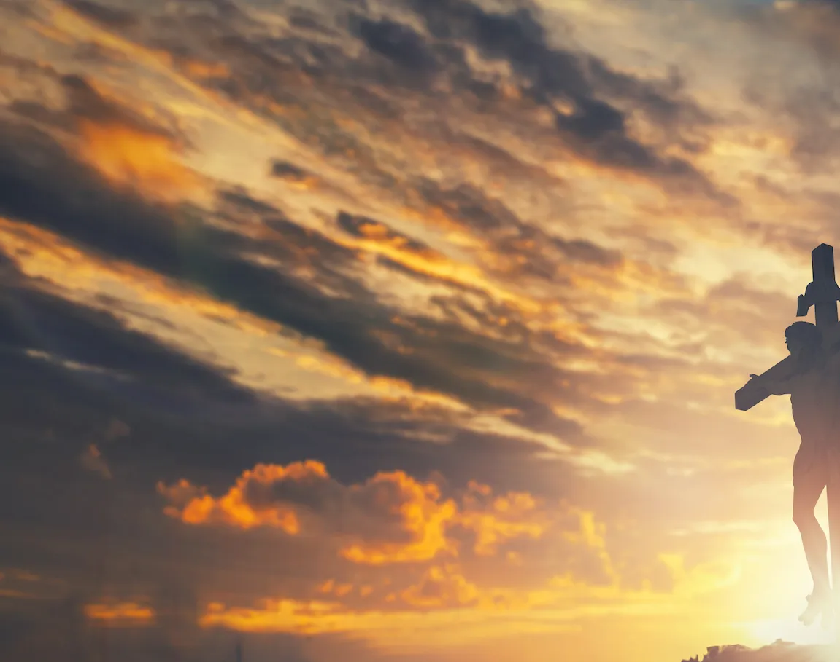
How Great is Our God

Slide 2
G Em
The splendor of the King Clothed in majesty
C
Let all the earth rejoice All the earth rejoice
G Em
He wraps Himself in light And darkness tries to hide
C
And trembles at his voice Trembles at his voice

Slide 3
G
How great is our God, sing with me
Em
How great is our God, all will see
C D G
How great, how great is our God

Slide 4
G Em
Age to age He stands And time is in His hands
C
Beginning and the end Beginning and the end
G Em
The Godhead, three in one Father, Spirit, Son
C
The Lion and the Lamb The Lion and the Lamb

Slide 5
G
Name above all names
Em
Worthy of all praise
C
My heart will sing
D G
How great is our God

